Slide 1

SUPERHERO U
DATA ANALYSIS OF CAMPAIGN RUN BY THEIR MARKETING TEAM.

Slide 2



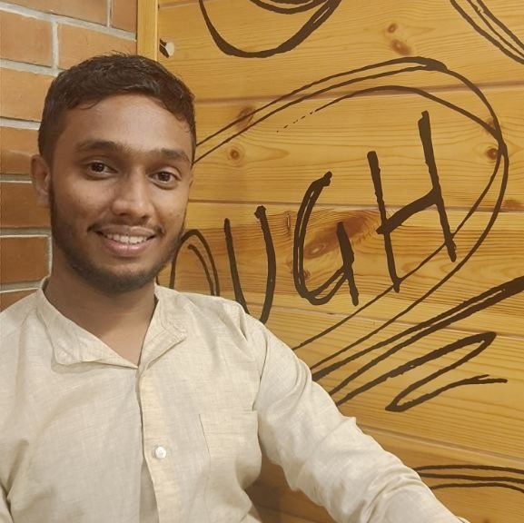

ABOUT US
TEAM NAME = DATA EXPLORERS
M MOBEEN UL HAQ
ALMAS TAMAKE
SHAMLAN AHMAD
ABHIJEET MANDULE
TEAM LEAD
PROJECT LEAD
PROJECT SCRIBE
PROJECT MANAGER

Slide 3

ABOUT SUPERHERO U
Superhero U was an initiative to enable creative and ardent young minds to make the greatest use of their abilities and imagination.
It was driven by the desire to develop a sense of invention and originality among our children.
Superhero U was a competitive event that aimed to give up-and-coming stars an encouraging and fair educational opportunity.
It was inspired by the UN's purpose "to promote prosperity while protecting the planet.“
The tailored "Superhero" would be created in a setting to address an important societal issue mentioned by the SDGs.
.

Slide 4

FACEBOOK ADS
There are ad solutions for every level of expertise.
Advertising with Facebook is easy.
We can Target The Right Audience.
The Marketing Team at GlobalShala has data exported from Facebook on the ad campaigns they ran for the Superhero U event.

Slide 5
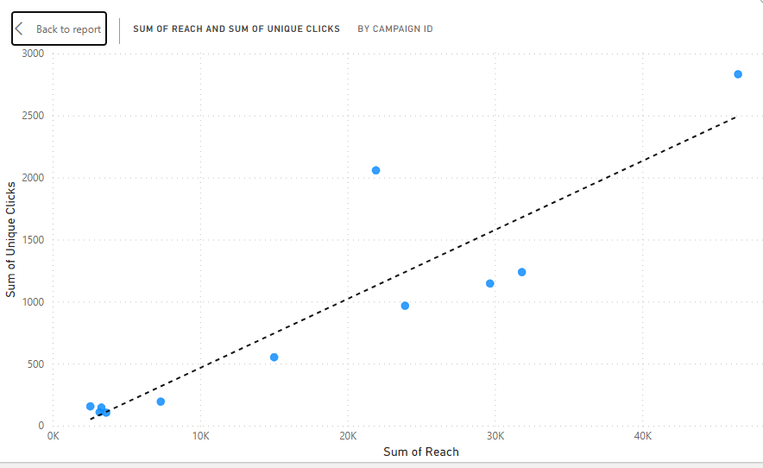
OVERVIEW OF SUPERHERO U ADD CAMPAIGNS
The comparisons of sum of people reaching to add and sum of ULC gives us order of effectiveness
add campaign (most to least effective) 2 8 6 7 1 5 9 11 4 10 3.

Slide 6
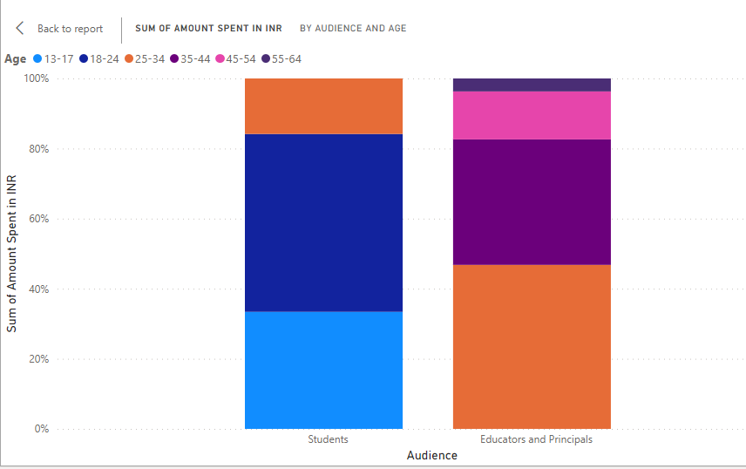
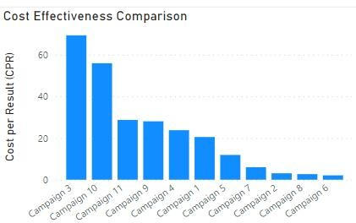
GRAPH SHOWING % OF AMOUNT SPENT OF ON AUDIENCE
Campaign 3 10 has high CPR.
ON STUDENTS AGEGROUP 13-17 INR 3258 , 18-24 INR 4952 AND AGEGROUP 25-34 INR 1544 IS SPENT.
WHILE ON EDUCATORS AND PRINCIPAL OF AGE GROUP 25-34 INR 2332 IS SPENT, AGE GROUP35-44 INR 835, AGE GROUP 45-54 INR 319, AND AGE GROUP 55-64 INR 86 IS SPENT.

Slide 7
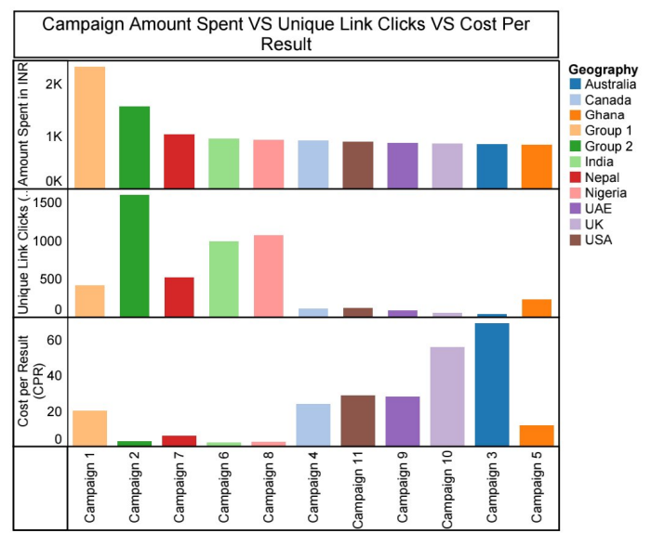
CPR, ULC COMPARISON FOR EACH CAMPAIGN.
It is notable that campaign 3 and 10 has resulted in Highest cost per result and have lowest unique Link Clicks .
Campaign 2 has lowest CPR and highest ULC.

Slide 8
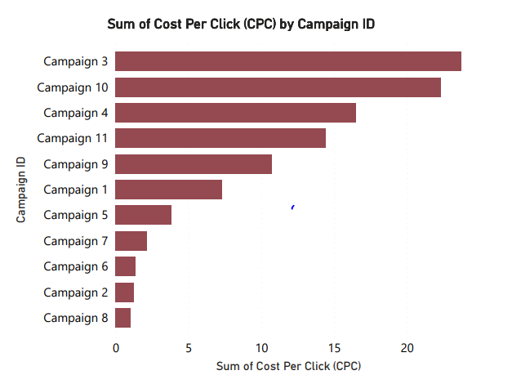
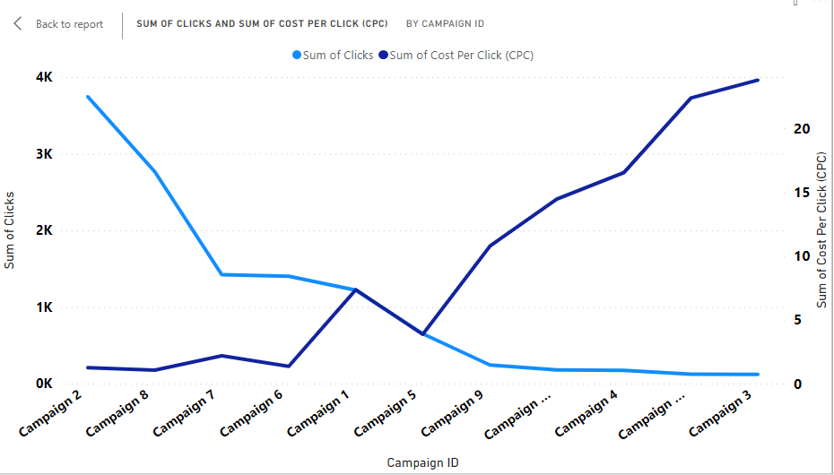
CAMPAIGN DISCONTINUED – Campaign 3
High cost
Low clicks
Notably, Campaign 3 exhibits a notably higher cost per click compared to the others, exceeding 20 INR per click.
Thus, it is prudent to deem Campaign 3 as the least efficient candidate for continuation. Campaign 3 has highest Cost and
Lowest clicks.

Slide 9
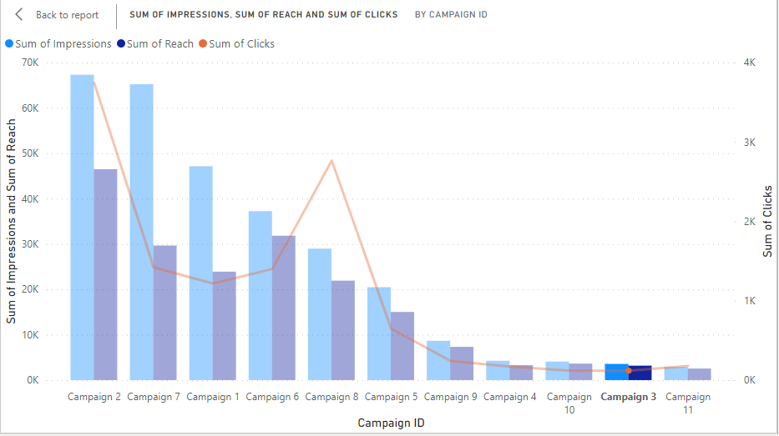
CAMPAIGN DISCONTINUED
Campaign 3 also has lowest sum of impressions, sum of reach, and sum of clicks.

Slide 10

The results of our analysis reveal several noteworthy insights.
Comparative analysis unveiled campaigns 3, 10 and 9 with notably lower CTR and higher Cost per Result, raising concerns about their effectiveness.
our analysis identified campaigns 3,10,11 and 9 with potential under-performance based on key metrics such as CTR, CPC, and cost per result.
Campaign 2 is most effective and campaign 3 is least effective add campaign.

Slide 11
Thank You regards team – data explorers

